Slide 1


01 / 31 / 2024
Introduction to the GeoAI Foundation Model and
Its Application
Yanhong Huang
Salar Jarhan
Jiyoung Lee
Claire Simpson
Yalin Yang

Slide 2
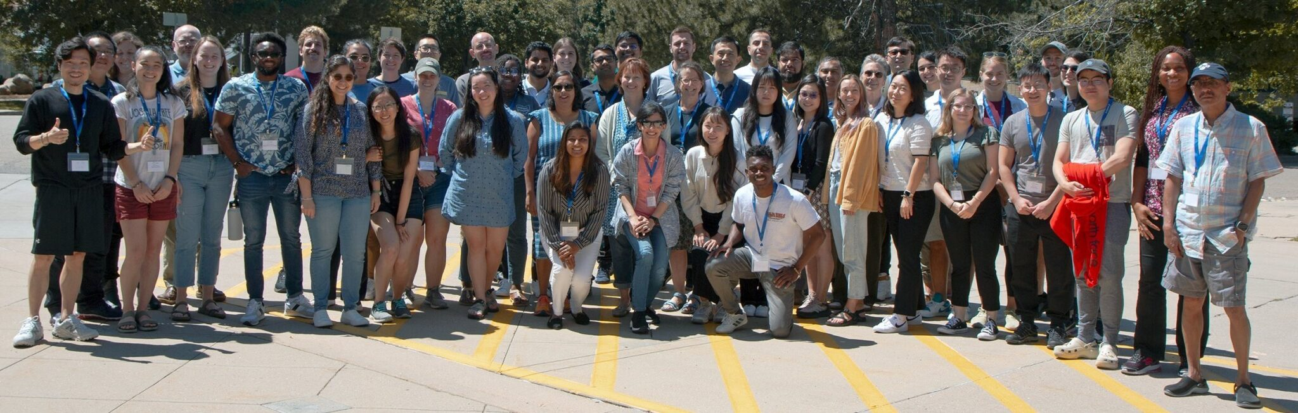

Summer School 2023: Convergence Science in Action
UCAR Campus in Boulder, Colorado · August 7-11, 2023
Apply Summer School 2024: https://iguide.illinois.edu/summer-school/summer-school-2024/

Slide 3



Team 6
Dr. Eric Shook
University of Minnesota Twin Cities
Dr. Diana Sinton
UCGIS & Cornell University
TeamAwesome
Yanhong Huang
Salar
Jarhan
University of Wyoming
Jiyoung
Lee
Louisiana State University
Claire Simpson
University of Colorado, Boulder
Yalin
Yang
University of Texas at Dallas
University of New Mexico

Slide 4
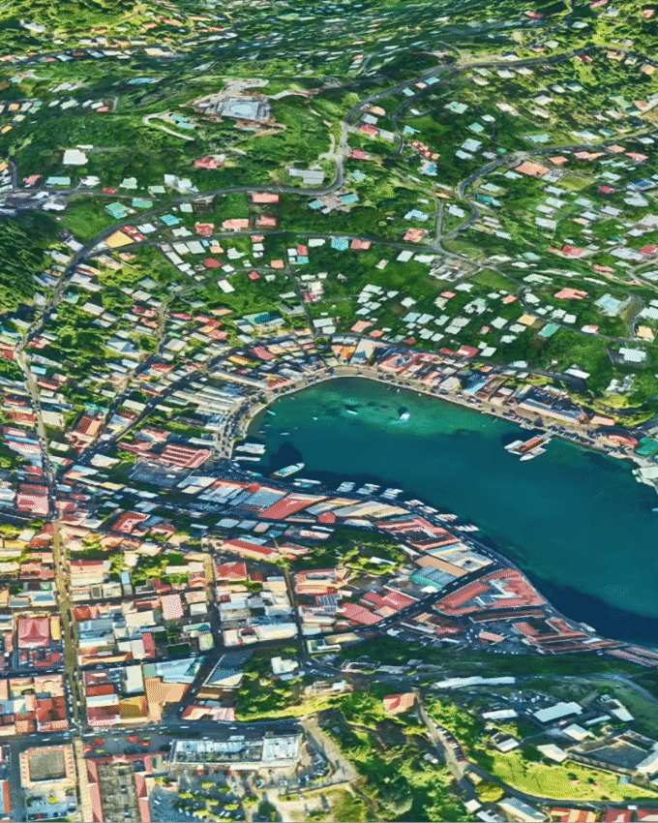
Geospatial Artificial Intelligence (GeoAI)
Utilization of AI in conjunction with geographical data, science, and technology
Accelerate the comprehension of real-world business prospects, environmental effects, and operational threats.
(https://www.esri.com/en-us/capabilities/geoai/overview#:~:text=Geospatial%20artificial%20intelligence%20(GeoAI)%20is,environmental%20impacts%2C%20and%20operational%20risks.)

Slide 5
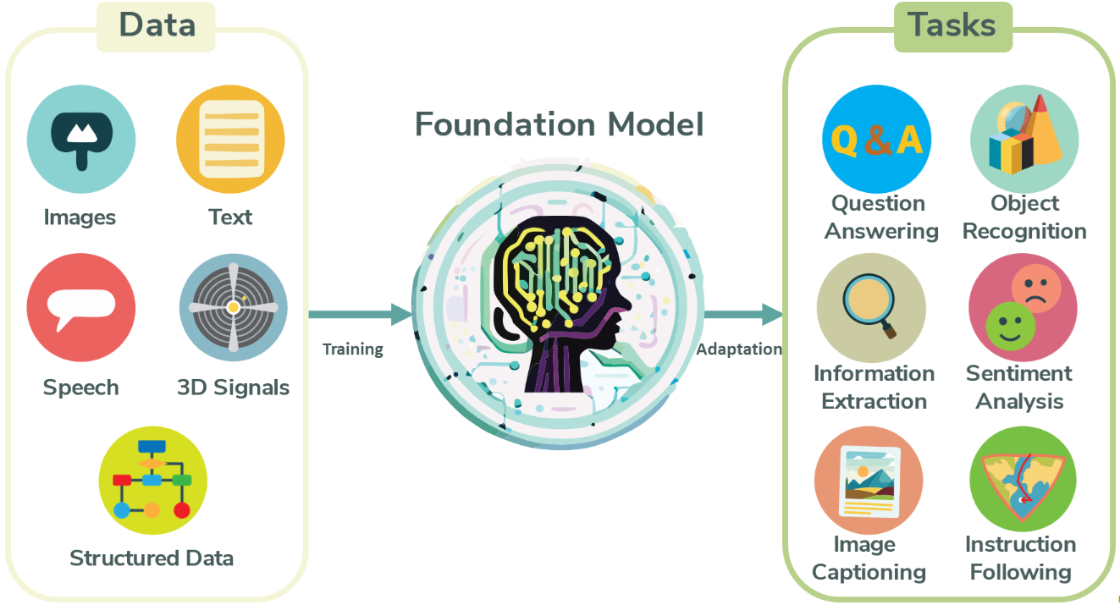
Foundation Model
(Adpated from https://blogs.nvidia.com/blog/2023/03/13/what-are-foundation-models/)

Slide 6




Fine-tuning
Pre-trained
Weight
New data
An approach to transfer learning
The weights of a pre-trained model are trained on new data
Emoji Kitchen: Cook Moji

Slide 7
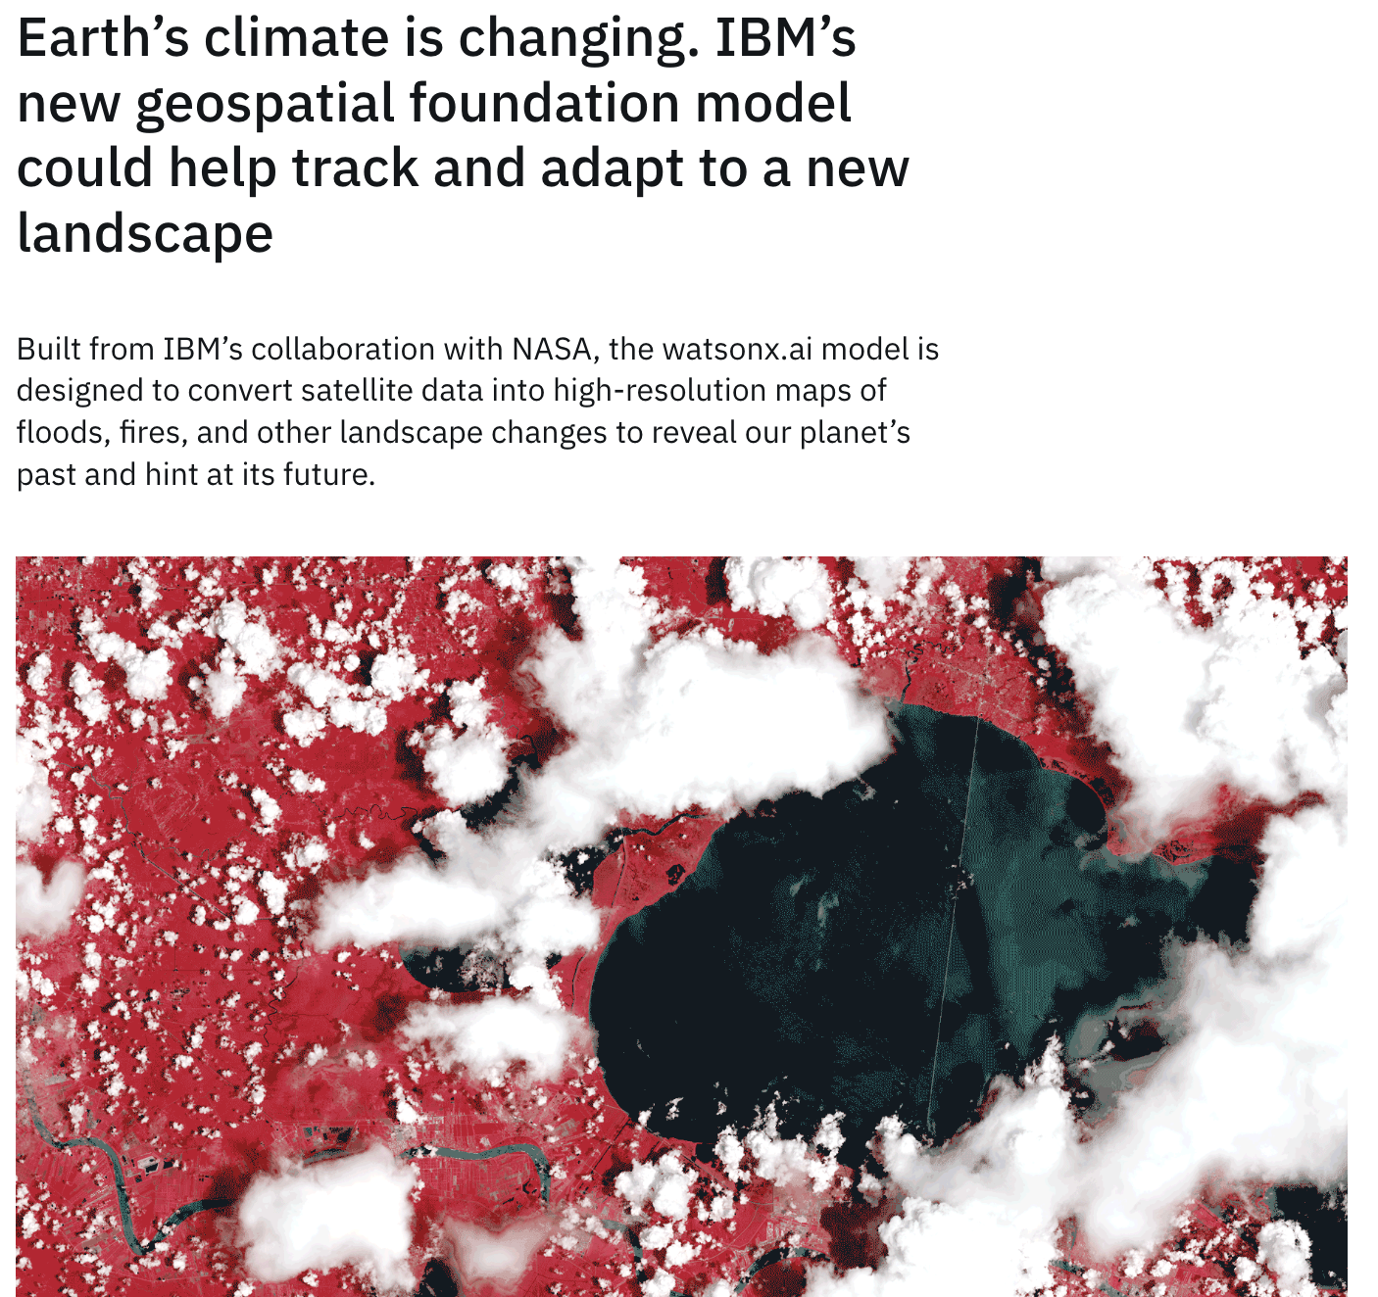
Background
Gain practical experience in applying deep learning techniques to real-world spatial problems, at the cutting edge of GeoAI
“NASA's first open-source geospatial artificial intelligence (AI) foundation model for Earth observation data…is a milestone in the application of AI for Earth science."
(https://www.earthdata.nasa.gov/news/impact-ibm-hls-foundation-model)

Slide 8
Prithvi-100M Model
Type: temporal Vision transformer
Pre-Training: pre-trained by the IBM and NASA team on contiguous US Harmonised Landsat Sentinel 2 (HLS) data.
Architecture:
Self-supervised encoder developed with a ViT architecture and Masked AutoEncoder (MAE) learning strategy, MSE loss function.
spatial attention across multiple patches temporal attention for each patch.

Slide 9
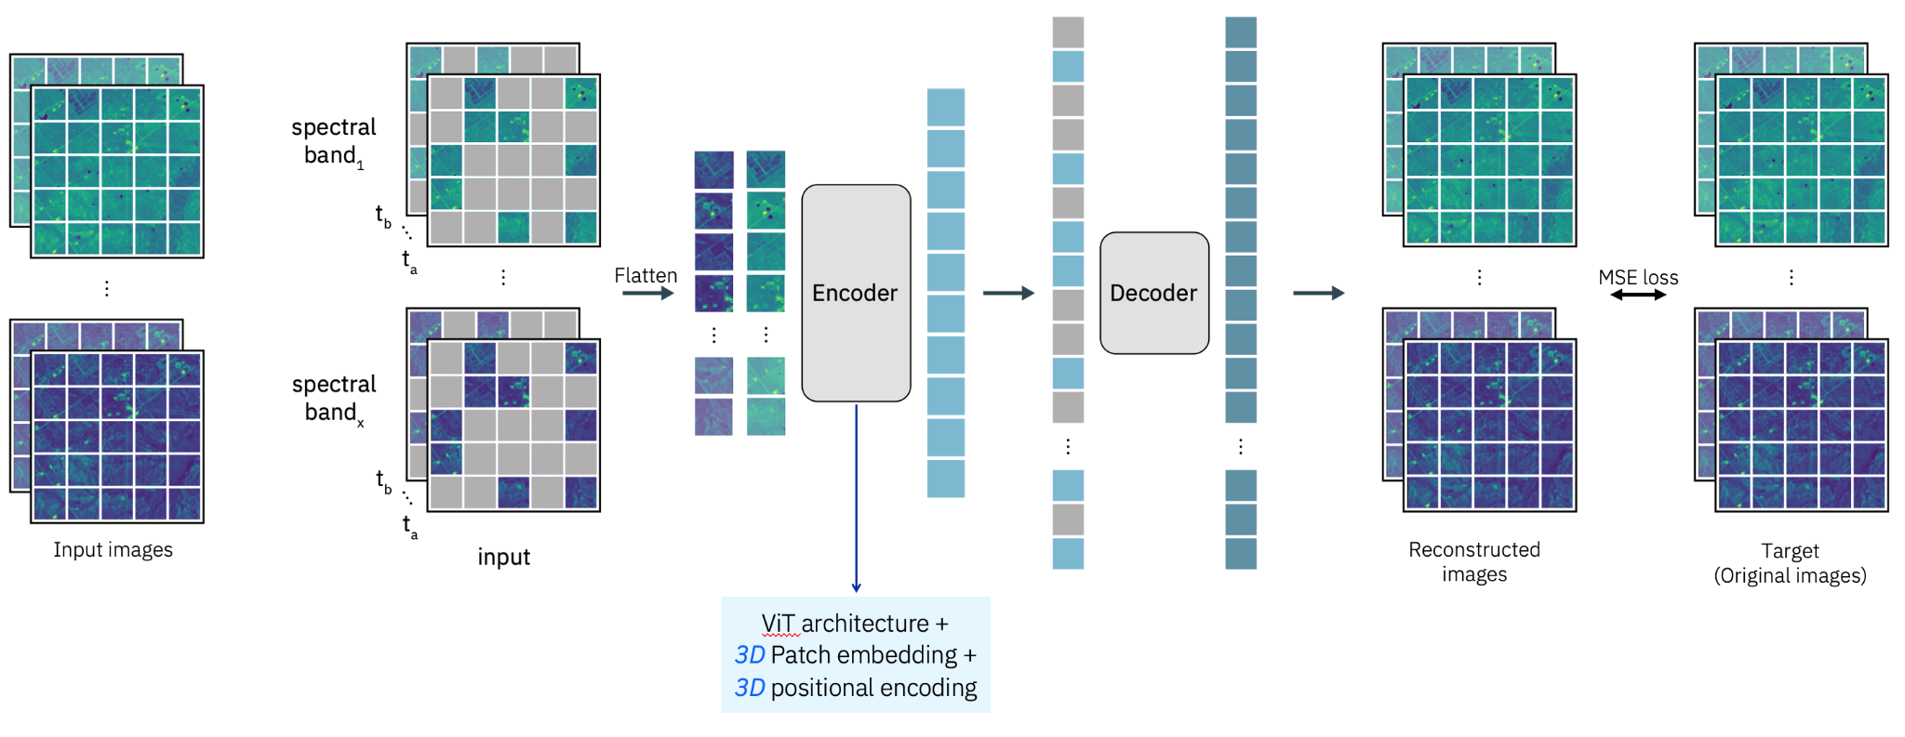
Prithvi-100M Model
(Source: https://huggingface.co/ibm-nasa-geospatial/Prithvi-100M/blob/main/README.md)

Slide 10
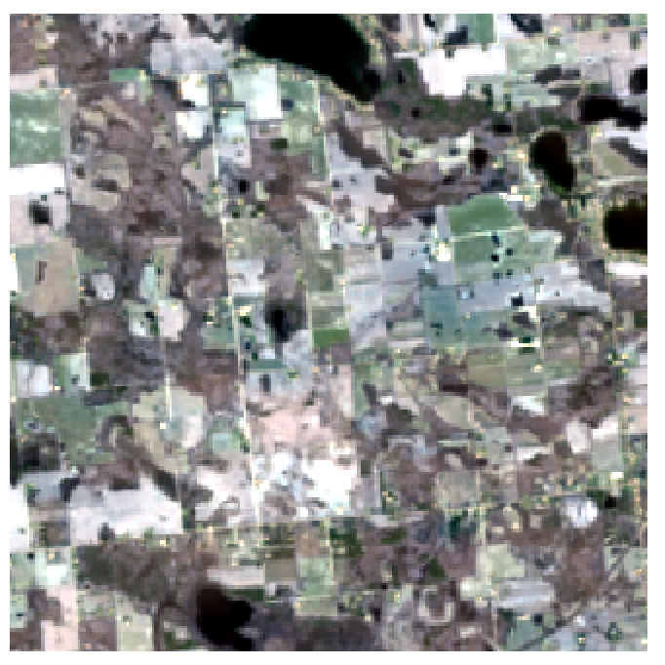
Data
Harmonized Landsat-Sentinel-2 (HLS)
Band Name | Data type | Scale | Unit | Saturation Flag | Spatial Resolution | Nadir Adjustment | Description
Coastal aerosol | int16 | 0.0001 | unitless | 12,000 | 30 | yes | Nadir-adjusted
Blue | int16 | 0.0001 | unitless | 12,000 |  |  | Surface Reflectance
Green | int16 | 0.0001 | unitless | 12,000
Red | int16 | 0.0001 | unitless | 12,000
NIR | int16 | 0.0001 | unitless | 12,000
SWIR 1 | int16 | 0.0001 | unitless | 12,000
SWIR 2 | int16 | 0.0001 | unitless | 12,000
TIRS B10 | int16 | 0.01 | Celsius |  |  |  | TOA BT
TIRS B11 | int16 | 0.01 | Celsius |  |  |  | TOA BT
QA | uint8 | refer to the QA table in the User’s Guide for bit information

Slide 11




Research Objectives
Deploy foundation model to the I-GUIDE Platform
Replicate model fine-tuning for flood, burn, and crop classification
Create our own fine-tuned model to detect built areas

Slide 12
Fine-tuning: Flooding
Fine-tuning: Flooding
Purpose: Predict flooded vs dry areas
Dataset: Sen1Floods11
a georeferenced dataset to train and test deep learning flood algorithms
446 labeled 512x512 chips
14 biomes, 357 ecoregions, and 6 continents of the world 11 flood events.
bands for flood mapping: Blue, Green, Red, Narrow NIR, SWIR 1, SWIR 2

Slide 13



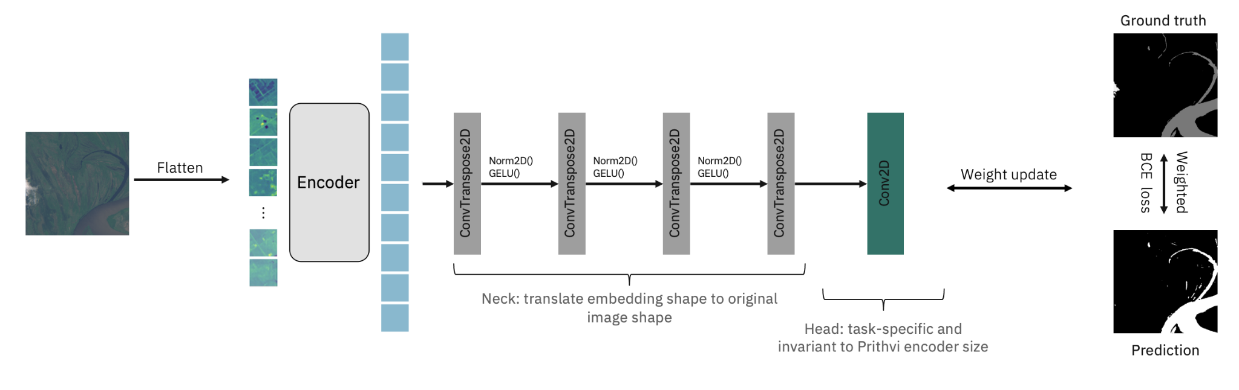
Fine-tuning: Flooding
Model Overview:
Label Categories:
Model Training Details:
Pretrained Model: Prithvi-100m.
Fine-tuning Purpose: Segmenting flood extent on Sentinel-2 images.
Class 0: No water.
Class 1: Water/Flood.
Class 2: No data/Clouds.
Initial Pretraining: 3 timesteps sequence length.
Focus: Single-timestamp segmentation.
Capability: Adaptable to an arbitrary number of timestamps during finetuning.
https://huggingface.co/ibm-nasa-geospatial/Prithvi-100M-sen1floods11

Slide 14
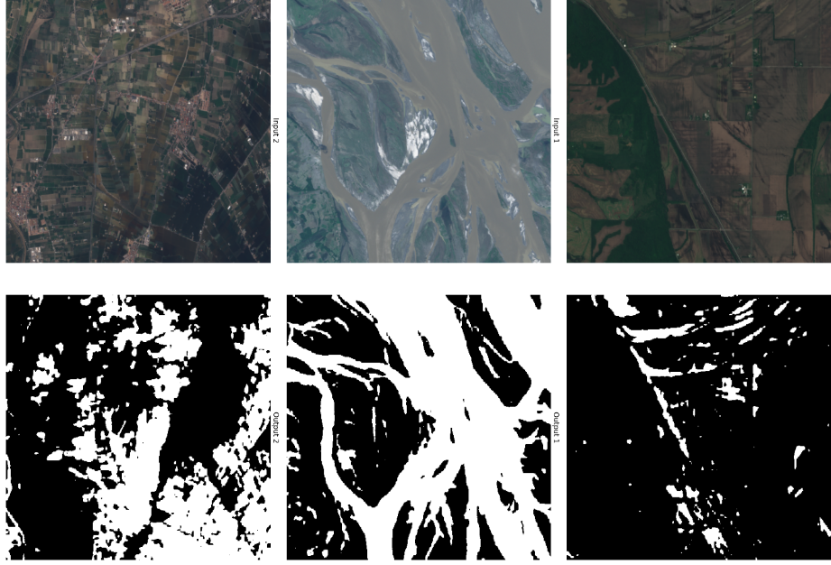
Fine-tuning: Flooding
Inputs (Raw Imagery)
Results
Finetuning the geospatial foundation model for 100 epochs leads to the following performance on the test dataset:
Classes | IoU | Acc
No water | 96.90% | 98.11%
Water/Flood | 80.46% | 90.54%
aAcc | mIoU | mAcc
97.25% | 88.68% | 94.37%
No water
Outputs (Binary Classification)
Water / Flood

Slide 15


Fine-tuning: Burn Scar
Purpose: Predict burned vs unburned areas after a fire
Data: 1-timestep HLS satellite image GeoTIFFs
512 x 512 pixels
Each tif file contains 6 spectral bands
Bands: Blue, Green, Red, Narrow NIR, SWIR 1, SWIR 2
Each GeoTIFF file for the mask contains one band, where each pixel represents the target binary class

Slide 16
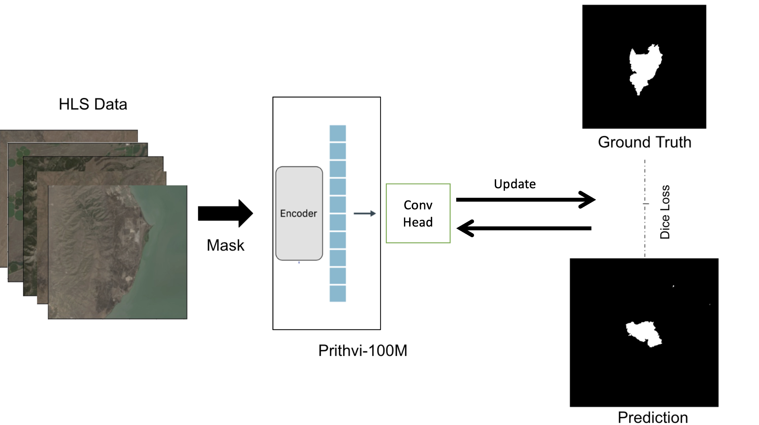
Fine-tuning: Burn Scar
Model Overview:
Pretrained Model: Prithvi-100m.
Fine-tuning Purpose: Segmenting burn scars.
Label Categories:
Class 0: Unburnt land.
Class 1: Burn scar.
Class 2: No data/Clouds.

Slide 17
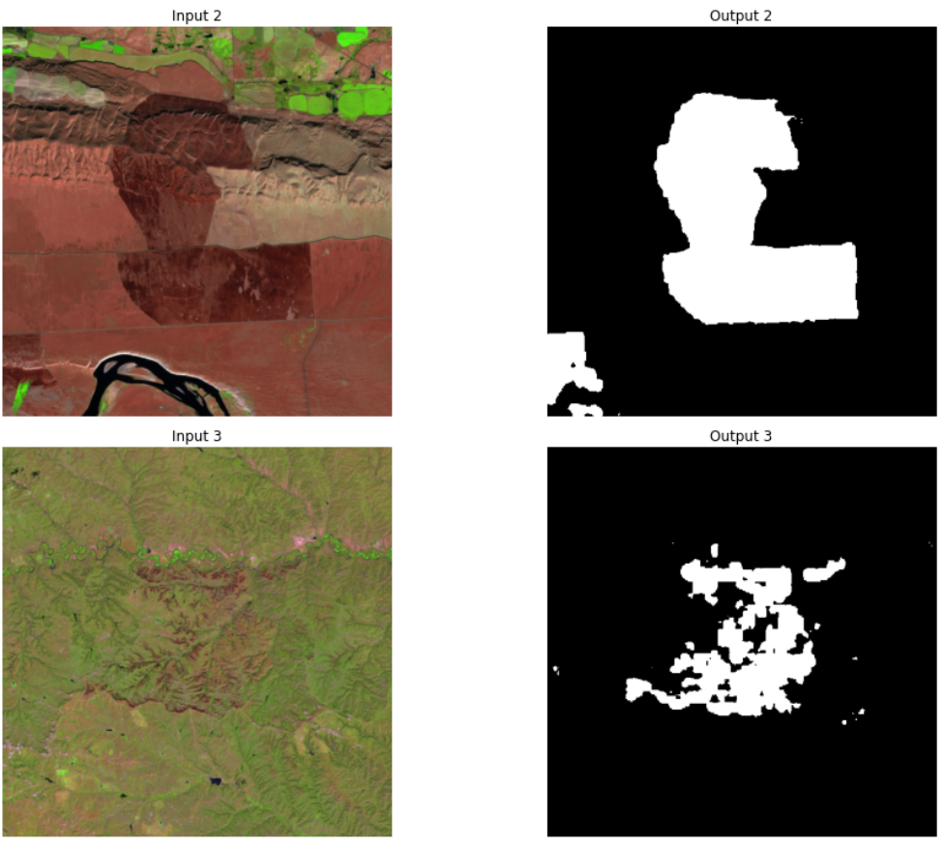
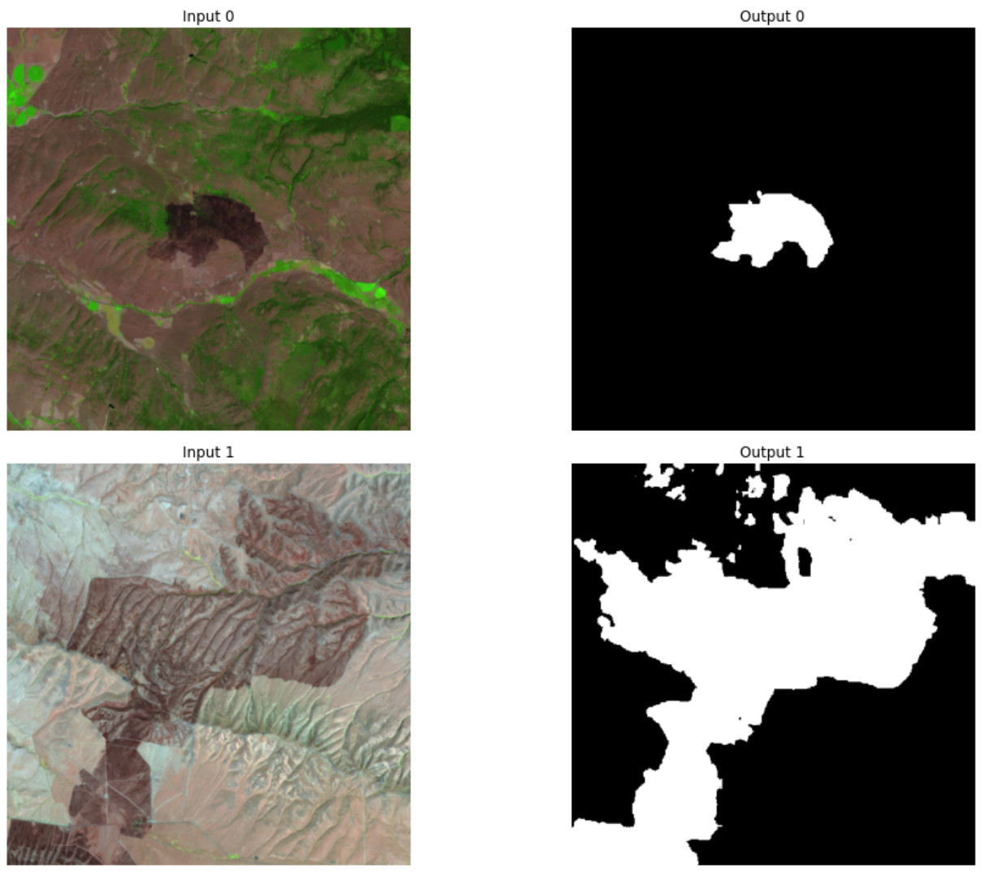
Fine-tuning: Burn Scar
Results
Finetuning the geospatial foundation model for 50 epochs leads to the following performance on the test dataset:
Inputs (Raw Imagery)
aAcc | mIoU | mAcc
96% | 76% | 94.37%
Unburnt land
Outputs (Binary Classification)
Burn scar

Slide 18
Fine-tuning: Crop Classification
This model differs from other fine-tuning tasks in that input data is multi-temporal (inputs contain data from three different timesteps).
Purpose: Predict 12 crop/landcover types.
224 x 224 pixels
Each tif file contains 18 bands: 6 spectral bands for 3 time steps stacked together
i.e., each GeoTIFF file represents three images acquired over the same spatial location at 3 different times
Each GeoTIFF file for the mask contains one band, where each pixel represents the target categorical class
Data: multi_temporal_crop_classification dataset

Slide 19
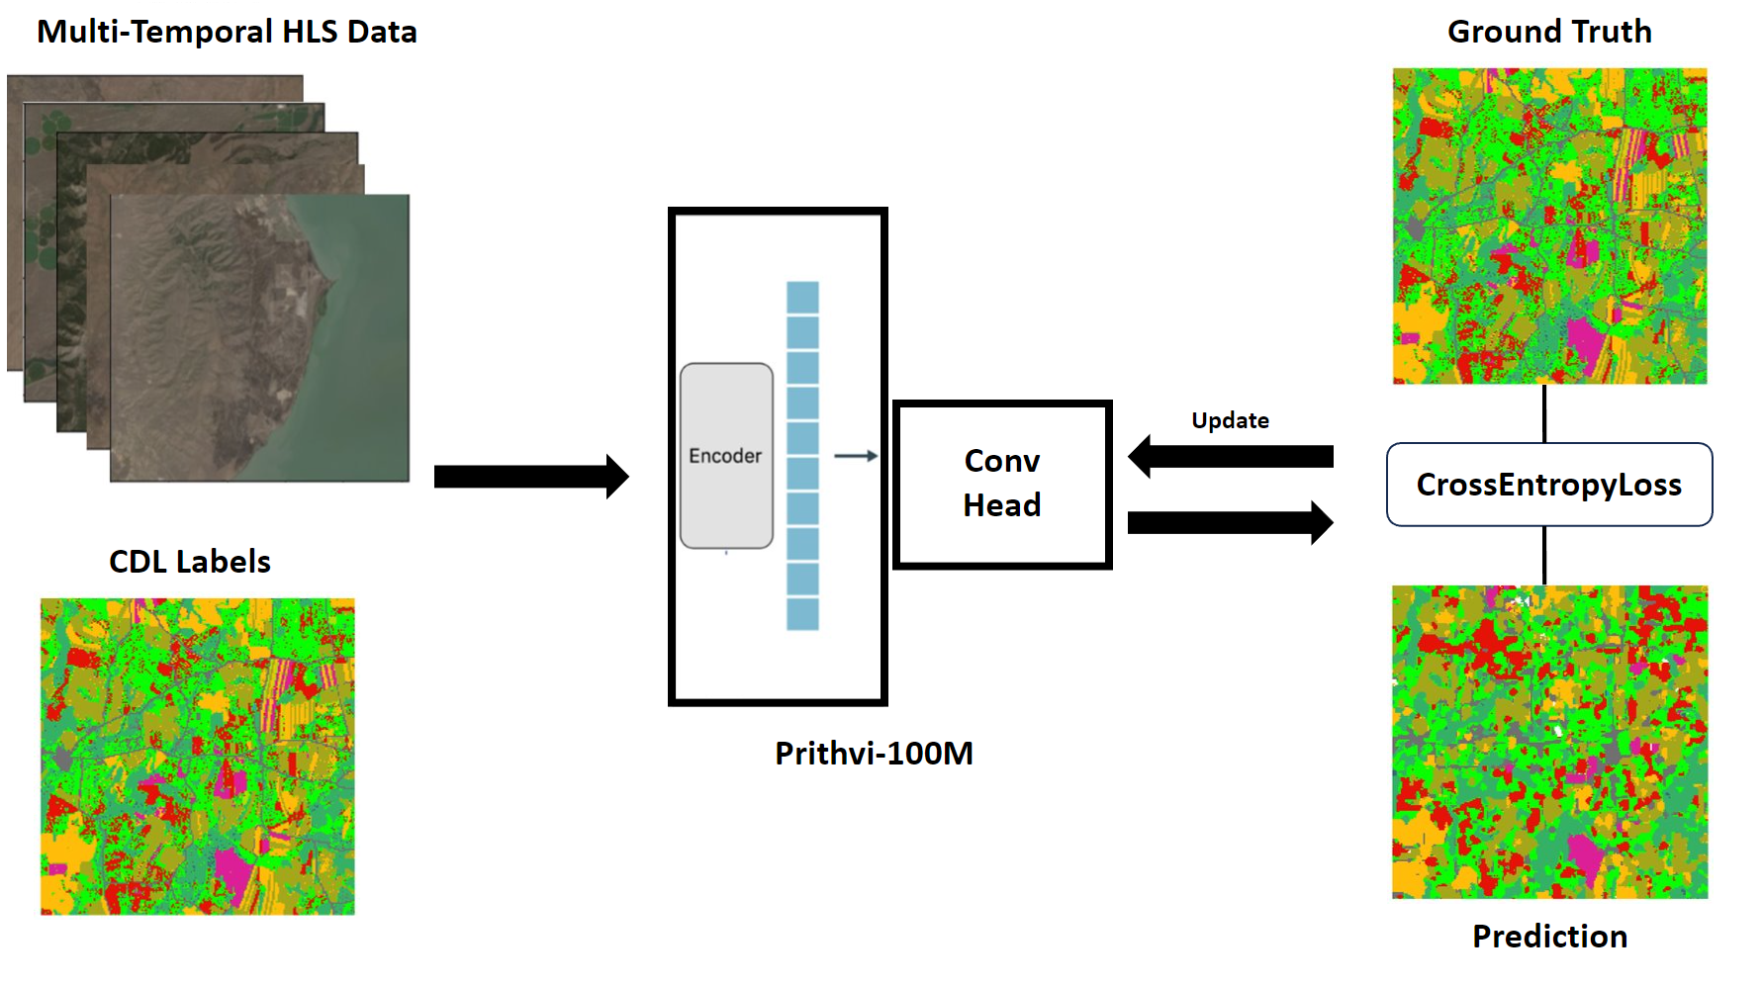
Fine-tuning: Crop Classification
Model Overview:
Pretrained Model: Prithvi-100m.
Fine-tuning Purpose: crop classification.
In each input GeoTIFF the following bands are repeated three times for three observations throughout the growing season: Channel, Name, HLS S30 Band number:
1, Blue, B02
2, Green, B03
3, Red, B04
4, NIR, B8A
5, SW 1, B11
6, SW 2, B12
Label Categories:
Class 0: Natural Vegetation.
Class 1: Forest.
Class 2: Corn.
Class 3: Soybeans.
Class 4: Wetlands.
Class 5: Developed/Barren.
Class 6: Open Water.
Class 7: Winter Wheat.
Class 8: Alfalfa.
Class 9: Fallow/Idle Cropland.
Class 10: Cotton.
Class 11: Sorghum.
Class 12: Other.
Class 13: No data/ Clouds.

Slide 20
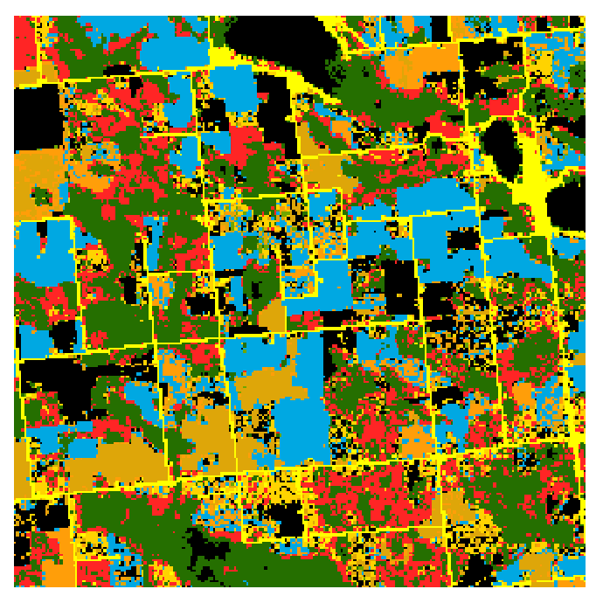
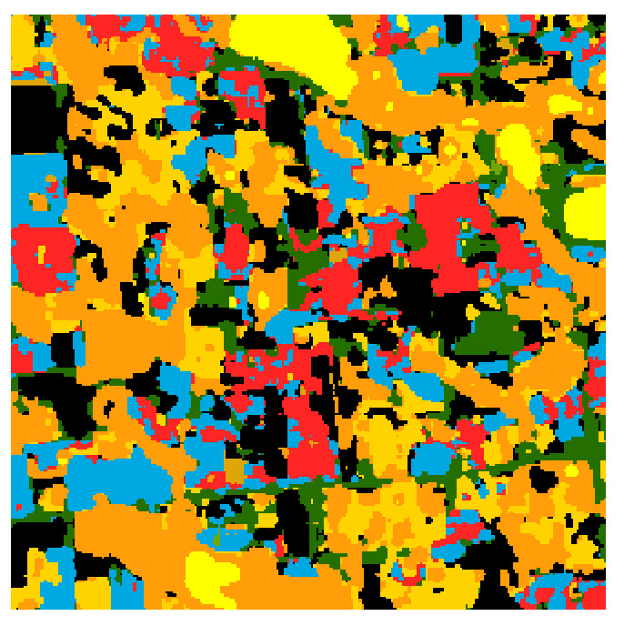
Fine-tuning: Crop Classification
Classes | IoU | Acc
Natural Vegetation | 0.4038 | 46.89%
Forest | 0.4747 | 66.38%
Corn | 0.5491 | 65.47%
Soybeans | 0.5297 | 67.46%
Wetlands | 0.402 | 58.91%
Developed/Barren | 0.3611 | 56.49%
Open Water | 0.6804 | 90.37%
Winter Wheat | 0.4967 | 67.16%
Alfalfa | 0.3084 | 66.75%
Fallow/Idle Cropland | 0.3493 | 59.23%
Cotton | 0.3237 | 66.94%
Sorghum | 0.3283 | 73.56%
Other | 0.3427 | 47.12%
aAcc | mIoU | mAcc
60.64% | 0.4269 | 64.06%
Multi-classification
Model Prediction
Input (Multi-Temporal Imagery)

Slide 21

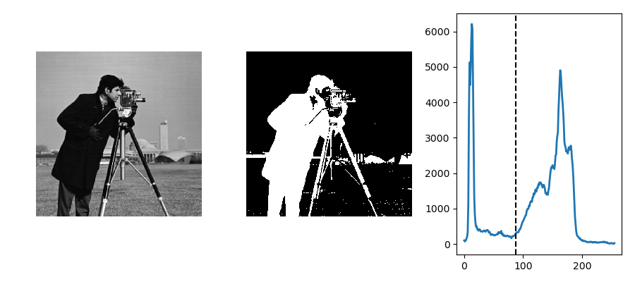
Fine-tuning Model for Our Novel Application
Normalized Difference Built-Up Index (NDBI) for Urban Mapping (Zha et al., 2003)
where SWIR is the mid-infrared and NIR is the near-infrared band
Otsu’s thresholding method

Slide 22
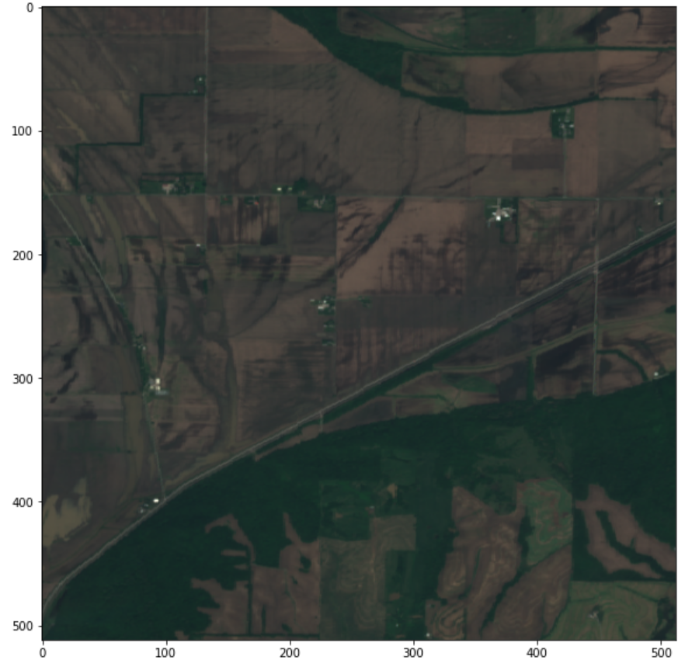
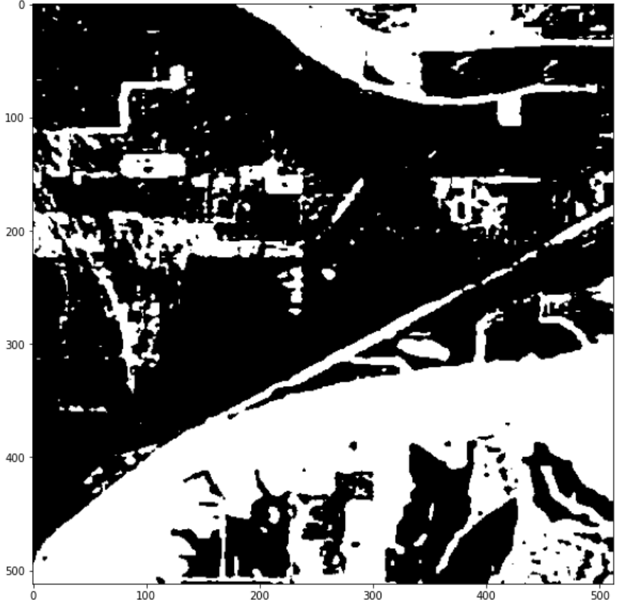
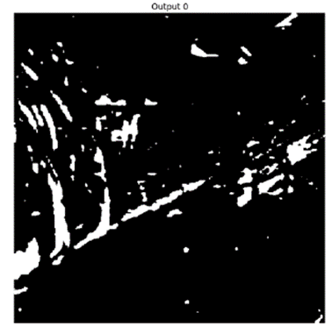
Fine-tuning Model for Our Novel Application
No water
Water / Flood
Non built up area
Built up area

Slide 23

Contributions
Data Card
Auditability
Ethics
Unintended use
Honest representation
Explainability

Slide 24
01 / 31 / 2024
Thank You
Q & A
Yanhong Huang (huangyh0906@unm.edu)
Salar Jarhan (Sjarhan@uwyo.edu)
Jiyoung Lee (jlee257@lsu.edu)
Claire Simpson (Claire.simpson@colorado.edu)
Yalin Yang(Yalin.Yang@UTDallas.edu)

